Slide 1




INFORMATION SYSTEMS 3D
INSY7314 /
APPLICATION DEVELOPMENT SECURITY
APDS7311

Slide 2



MODULE RESOURCES:
PM1: Manico, J. and Detlefsen, A. 2015. Iron-Clad Java: Building Se-cure Web Applications. ISBN: 978-0-07-183589-3
PM2: IIE Lab Guide
Links to additional resources on the module outline

Slide 3

INTRODUCTION
This module aims to helps understand the most common threats against web applications today and learn a wide variety of security techniques to help you build web applications that prevent these attacks from being successful.

Slide 4


ASSESSMENT PREPARATION GUIDELINES
Part 1
This assessment will assess your understanding of Learning Unit 1 to 2.
Part 2
The assessment will assess your ability to integrate and apply the content in Learning Units 1 to 4.

Slide 5



Portfolio of Evidence (PoE)
The PoE will consist of Part 1 and Part 2 as described above, as well as further activities to complete for the final PoE.
All learning units will be assessed in the PoE and reflection on your learning will be included.

Slide 6
LEARNING UNIT 1: INTRODUCTION TO WEB APPLICATION SECURITY
Importance of Proxy Server Settings - Chapter 1
Modern web security testing (and attacks) often starts by rerouting your browser through an intercepting proxy. By changing your browser’s proxy server settings to point at a local port, all HTTP(S) requests flow through a tool such as Burp Suite or OWASP ZAP. This lets you:
Record every request and response to see exactly what your application is sending and receiving.
Intercept and modify request parameters, headers, cookies, and even the HTTP verb before it reaches the server.
By forcing traffic through a proxy, you gain visibility and control over every aspect of the HTTP exchange, an essential first step in both pen‑testing and securing an application.

Slide 7

The Threat of Untrusted Data - Chapter 1
Untrusted data is any information entering your system that isn’t hard‑coded or generated internally. That includes:
User‑typed input or file uploads
Data from third‑party services or RSS feeds
Even records pulled from your own database
Because an attacker can tamper with any part of an HTTP request, every field must be treated as potentially malicious.
Failure to validate or sanitize this data opens the door to injection, parameter‑tampering, session hijacking, and countless other attacks.

Slide 8

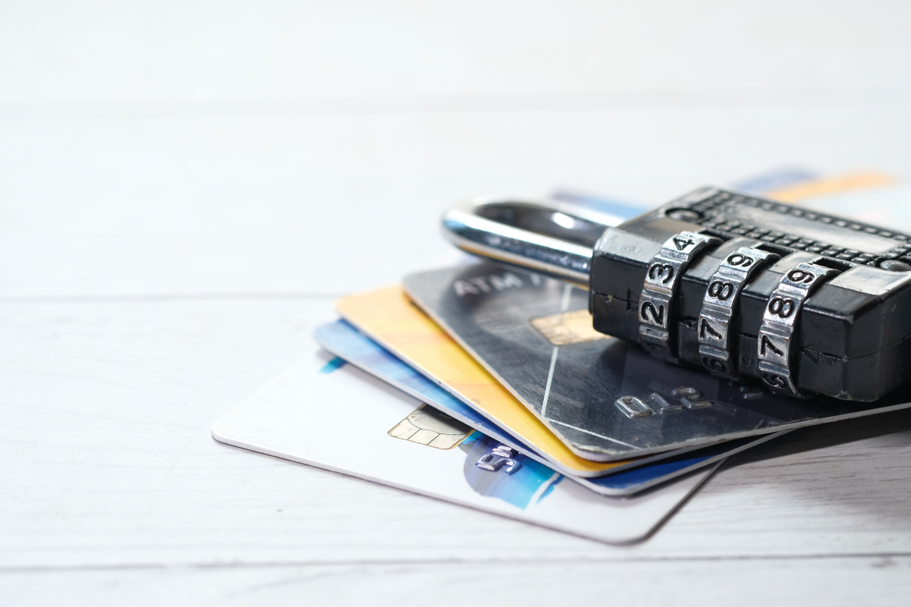

How HTTP Drives Web Traffic - Chapter 1
At its core, HTTP (Hypertext Transfer Protocol) is a simple, stateless, request‑and‑response protocol that underpins virtually every browser interaction.
Every click on a link, form submission, AJAX call, or resource fetch generates an HTTP request, specifying a verb (GET, POST, etc.), a target URL, headers, and (for GET) URL parameters or (for POST) a message body. Understanding this flow is fundamental to both building and securing web applications.
With these foundations - proxy‑based inspection, rigorous distrust of all external input, and deep familiarity with HTTP’s mechanics, students will be well‑prepared to explore more advanced security controls in lab and production environments.

Slide 9
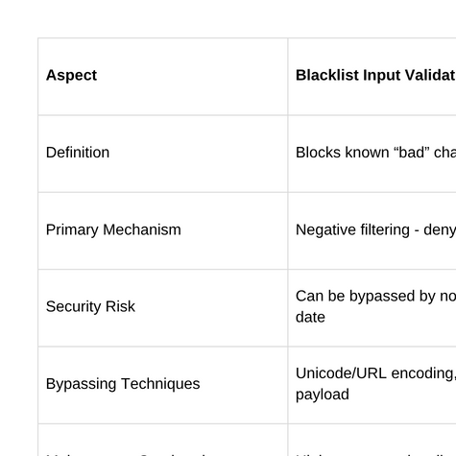
BLACKLIST INPUT VALIDATION VS
LACK OF PARAMETERIZED SQL

Slide 10
POSITIVE DEFENSIVE PATTERNS
Query Parameterization
Use your language’s “prepared statements” (e.g., java.sql.PreparedStatement) to bind untrusted data into placeholders. This cleanly separates query structure from data and makes injection impossible.
Whitelisting (Strict Input Validation)
Instead of blocking bad input, define exactly what’s allowed.
A phone‑number field: only digits, spaces, hyphens, parentheses, plus‑signs.
Everything else is rejected and logged.
Layered Controls (Defense in Depth)
Combine multiple controls to contain any slip‑through:
Least‑privilege DB accounts
Parameterization for all queries
Whitelist validation where parameterization isn’t possible
Escaping as a last resort

Slide 11
INPUT VALIDATION AS A PROGRAMMING TECHNIQUE
Input validation is one of the first lines of defence; it restricts what data your application will legally accept, rejecting everything else up front.
How it works:
Parse/check (e.g. numeric parsing or regex)
Enforce length and format constraints
Reject non‑conforming data before it reaches business logic

Slide 12

THANK YOU

